Slide 1
MPU 6050

Slide 2
MPU6050 CONFIGURATION
First of all, we will set FS (full scale) and the gyroscopes’ sensitivity per LSB (least significant bit) for both gyro and acc
The register for configuring the gyroscope is Register 27, named GYRO_CONFIG. For each FS value, we will have respectively the gyroscopes’ sensitivity per LSB. They are shown on below
0: +- 250 degrees/sec with 131 LSB/degree/sec
1: +- 500 degrees/sec with 65.5 LSB/degree/sec
2: +- 1000 degrees/sec with 32.8 LSB/degree/sec
3: +- 2000 degrees/sec with 16.4 LSB/degree/sec

Slide 3
MPU6050 CONFIGURATION
Similarly, for accelerometer we also have pair of FS (full scale) and sensitivity per LSB (register 28)
•
AFS_SEL = 0 (±2g): 16384 LSB/g
•
AFS_SEL = 1 (±4g): 8192 LSB/g
•
AFS_SEL = 2 (±8g): 4096 LSB/g
•
AFS_SEL = 3 (±16g): 2048 LSB/g

Slide 4
MPU6050 CONFIGURATION
The PWR_MGMT_1 (Power Management 1) register in the MPU-6000/MPU-6050 (address 107) allows configuration of power modes and clock source
The SMPLRT_DIV (Sample Rate Divider) register, number 25 in the MPU-6000/MPU-6050 documentation, is used to specify the divider from the gyroscope output rate to generate the Sample Rate for the MPU-60X0.
Sample Rate = Gyroscope Output Rate / (1 + SMPLRT_DIV)

Slide 5
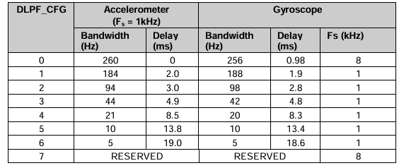
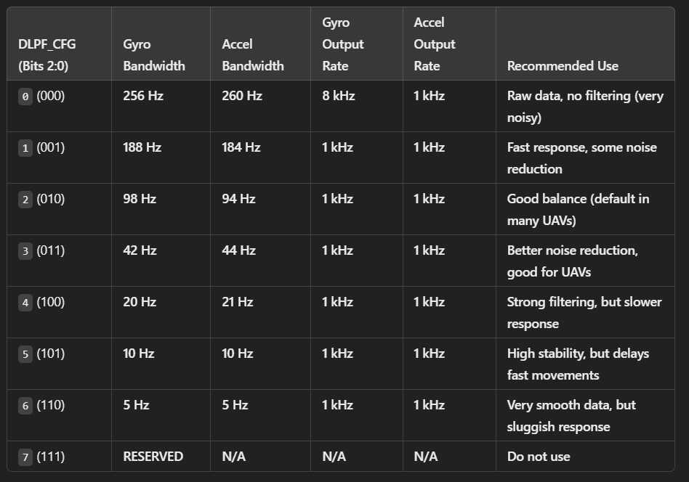
MPU6050 CONFIGURATION
Digital Low Pass Filter (DLPF) setting (register 26), depending on value of Sample Rate to choose value for DLPF. You can see in table below:

Slide 6
MPU6050 CONFIGURATION
The register GYRO_CONFIG (address 27 in decimal, 1B in hex) is used to trigger gyroscope self-test and configure the gyroscope's full scale range.
FS_SEL: Selects the full-scale range of the gyroscope outputs:
0: ± 250 °/s
1: ± 500 °/s
2: ± 1000 °/s
3: ± 2000 °/s

Slide 7
MPU6050 CONFIGURATION
The ACCEL_CONFIG register (address location 28 in decimal or 1C in hex).
0: ± 2g
1: ± 4g
2: ± 8g
3: ± 16g

Slide 8
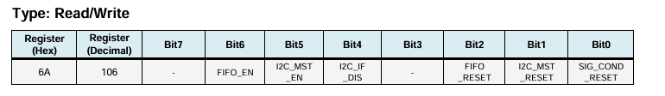
MPU6050 CONFIGURATION
The USER_CTRL register (Register 106) in the MPU-6000/MPU-6050 allows you to enable/disable the FIFO buffer, the I2C Master Mode, and the primary I2C interface.
I2C_MST_EN: When set to 1, this bit enables I2C Master Mode. When this bit is cleared to 0, the auxiliary I2C bus lines (AUX_DA and AUX_CL) are logically driven by the primary I2C bus (SDA and SCL).

Slide 9
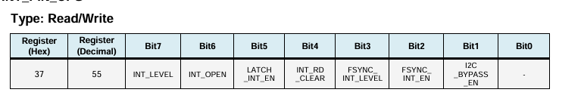
MPU6050 CONFIGURATION
The INT_PIN_CFG register (Interrupt Pin Configuration), located at address 55, is used to configure the operation of interrupt signals on the INT pin of the MPU-6000/MPU-6050.
I2C_BYPASS_EN: When this bit is equal to 1 and I2C_MST_EN (Register 106 bit[5]) is equal to 0, the host application processor will be able to directly access the auxiliary I2C bus of the MPU-60X0.

Slide 10

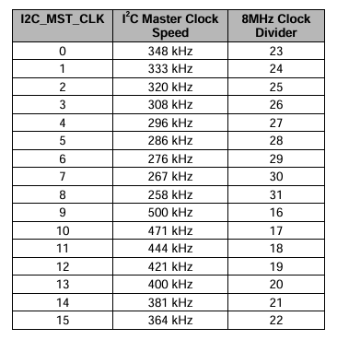
MPU6050 CONFIGURATION
I2C_MST_CTRL (I2C Master Control) is a register in the MPU-6000/MPU-6050, located at address 36 (0x24 hex)
I2C_MST_CLK is a 4 bit unsigned value which configures a divider on the MPU-60X0 internal 8MHz clock. It sets the I2C master clock speed according to the following table:

Slide 11
MPU6050 CONFIGURATION
Registers 37 to 39 – I2C Slave 0 Control:
I2C_SLV0_ADDR
I2C_SLV0_REG
I2C_SLV0_CTRL
I2C_SLV0_ADDR is a register in the MPU-6000/MPU-6050 used to specify the I2C address of the Slave 0 device. This register is located at address 37 (0x25 hex).
I2C_SLV0_REG is a register in the MPU-6000/MPU-6050 used to specify the internal register address of Slave 0 where data transfer will start. It is located at address 38 (0x26 hex).
I2C_SLV0_CTRL is a register in the MPU-6000/MPU-6050 used to control data transfer for Slave 0 via the I2C interface. This register is located at address 39 (0x27 hex)

Slide 12
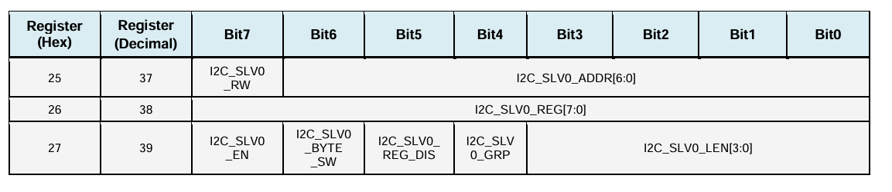
MPU6050 CONFIGURATION
I2C_SLV0_RW: When set to 1, this bit configures the data transfer as a read operation. When cleared to 0, this bit configures the data transfer as a write operation.
I2C_SLV0_ADDR: Bits 6 through 0 (I2C_SLV0_ADDR[6:0]) contain the 7-bit I2C address of Slave 0
I2C_SLV0_REG: 8-bit address of the Slave 0 register to/from which data transfer starts.
I2C_SLV0_EN: When set to 1, this bit enables Slave 0 for data transfer operations. When cleared to 0, this bit disables Slave 0 from data transfer operations.
I2C_SLV0_LEN: 4-bit unsigned value. Specifies the number of bytes transferred to and from Slave 0.

Slide 13
HMC5883L CONFIGURATION
Configuration Register A (address 0x00)
It is an 8-bit read/write register used to configure the device.
Bit CRA7 must be cleared to 0 for correct operation.
Bits CRA6-CRA5 (MA1-MA0) select the number of samples averaged per measurement (1, 2, 4, or 8).
Bits CRA4-CRA2 (DO2-DO0) set the data output rate in continuous measurement mode....
Bits CRA1-CRA0 (MS1-MS0) define the measurement configuration, including normal measurement and positive/negative bias configurations used for self-test.

Slide 14
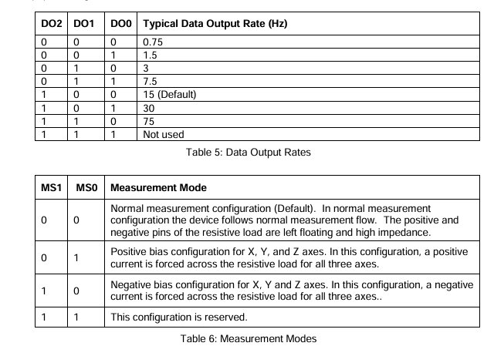
HMC5883L CONFIGURATION

Slide 15
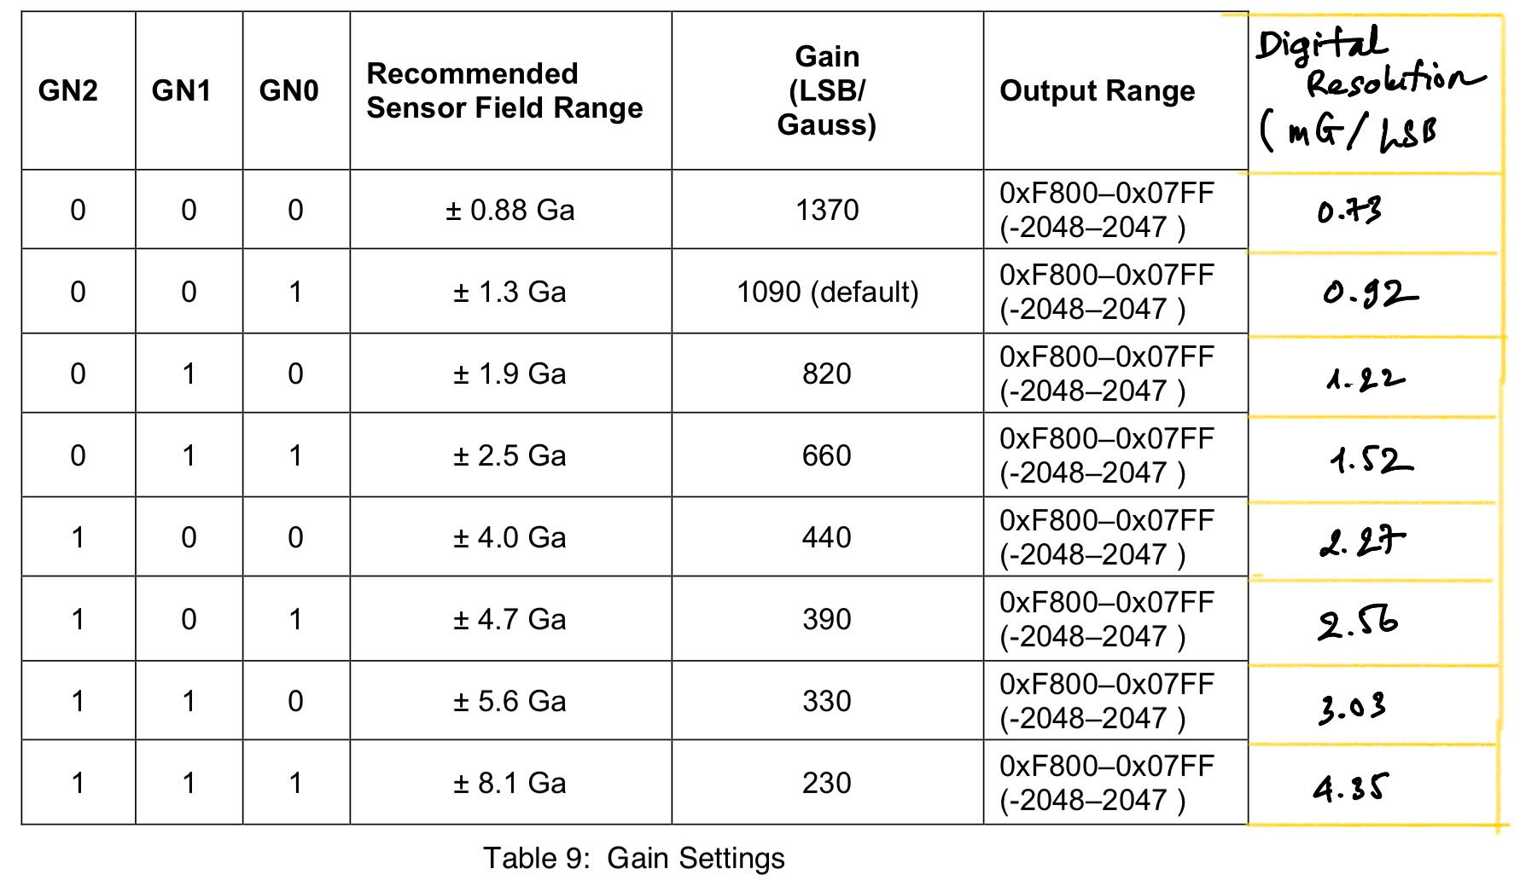
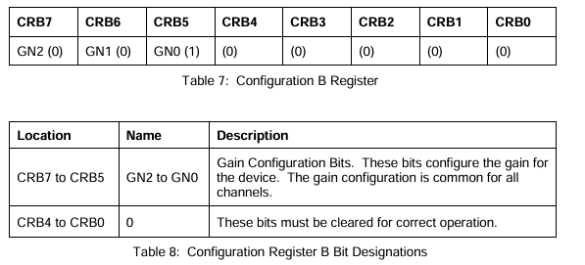
HMC5883L CONFIGURATION
Configuration Register B (address 0x01) is an 8-bit read/write register used to configure the gain of the device

Slide 16
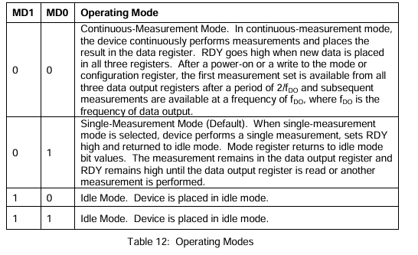
HMC5883L CONFIGURATION
The Mode Register (address 0x02) used to select the operating mode of the HMC5883L device.
MR7 to MR2: These bits must be cleared to 0 for correct operation3. Bit MR7 is set internally after each single-measurement operation.
MR1 to MR0 (MD1 to MD0): These are the Mode Select Bits. They determine the operating mode of the device.

Slide 17
KALMAN FILTER
Read this post to get more information:
TKJ Electronics » A practical approach to Kalman filter and how to implement it

Slide 18
MS5611 CONFIGURATION
I2C mode
The MS5611-01BA has only five basic commands:
Reset
Read PROM (128 bit of calibration words)
D1 conversion
D2 conversion
Read ADC result (24 bit pressure / temperature)

Slide 19
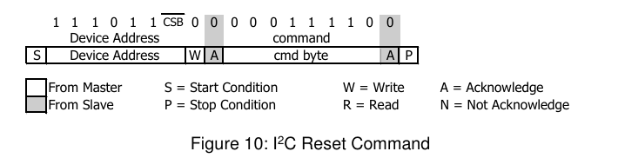
MS5611 CONFIGURATION
Reset command(0x1E)
Device Address(0x77)

Slide 20
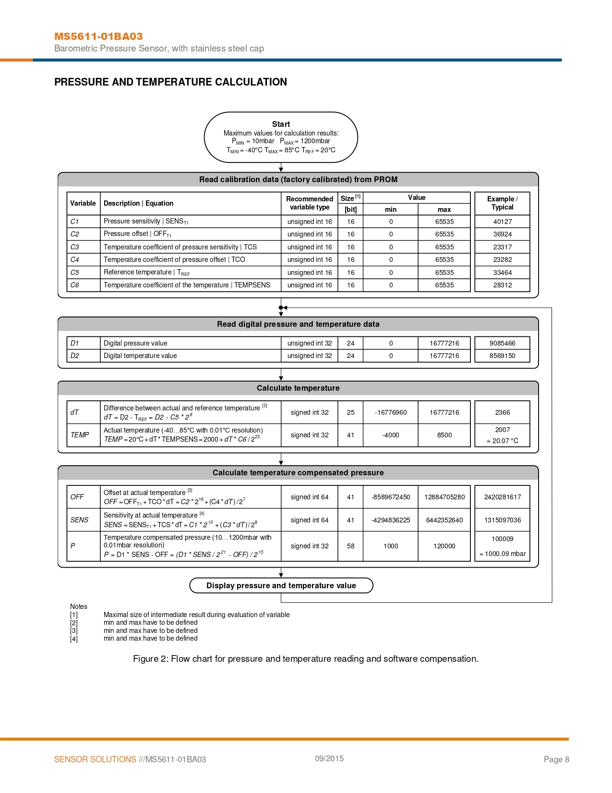

Slide 21
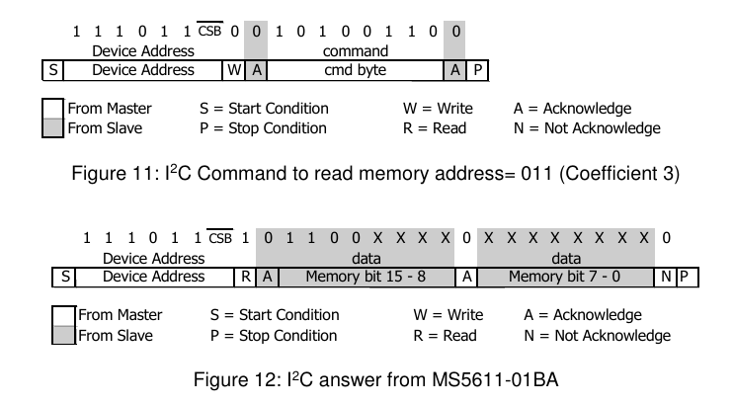
MS5611 CONFIGURATION
Read Prom command
According to datasheet, we can get data in prom by following 2 steps below:
#define CMD_PROM_C0 0xA0
#define CMD_PROM_C1 0xA2
#define CMD_PROM_C2 0xA4
#define CMD_PROM_C3 0xA6
#define CMD_PROM_C4 0xA8
#define CMD_PROM_C5 0xAA
#define CMD_PROM_C6 0xAC
#define CMD_PROM_C7 0xAE

Slide 22
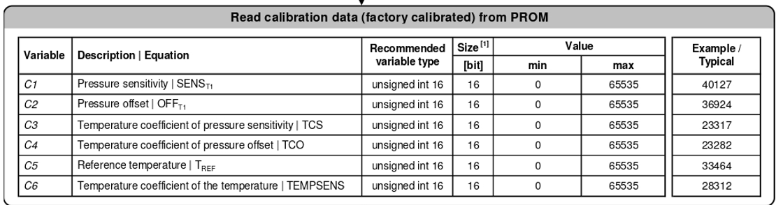
MS5611 CONFIGURATION
However, you can read them directly from their addresses (all defined commands above are also their addresses) like I did in my code.
Example:
DataStruct->C[1] = wiringPiI2CReadReg8(fd_MS,CMD_PROM_C1) << 8 | wiringPiI2CReadReg8(fd_MS,CMD_PROM_C1 + 1);

Slide 23
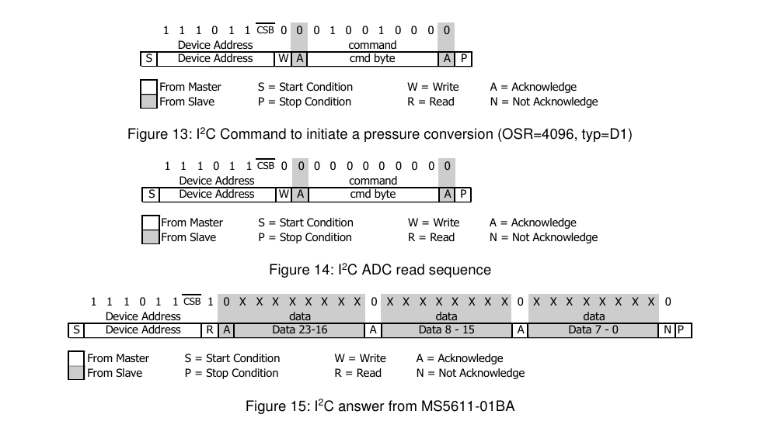
MS5611 CONFIGURATION
Read digital result
To read digital result we follow 3 steps from datasheet

Slide 24
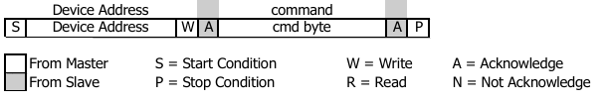
MS5611 CONFIGURATION
Step 1:
Setting OSR (oversampling rate) for pressure and temperature
Cmd byte
Pressure:
#define PRESSURE_OSR_256 0x40
#define PRESSURE_OSR_512 0x42
#define PRESSURE_OSR_1024 0x44
#define PRESSURE_OSR_2048 0x46
#define PRESSURE_OSR_4096 0x48
Temperature:
#define TEMP_OSR_256 0x50
#define TEMP_OSR_512 0x52
#define TEMP_OSR_1024 0x54
#define TEMP_OSR_2048 0x56
#define TEMP_OSR_4096 0x58

Slide 25
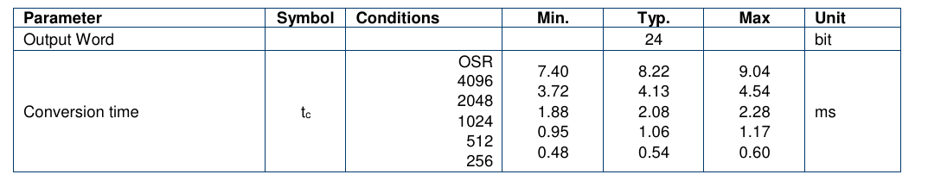
MS5611 CONFIGURATION
After setting OSR, device stays in busy until finishing conversion (conversion time). This means, we only read data after conversion time. You can use delay or interrupt to read data.

Slide 26
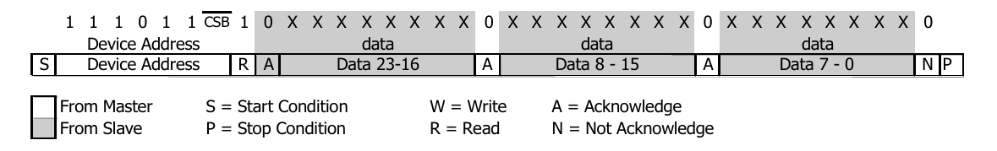
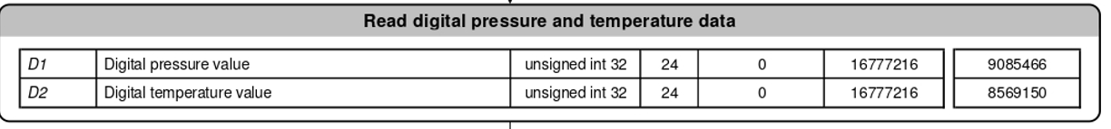
MS5611 CONFIGURATION
Step 2: Sending I2C ADC read sequence
Step 3: Read data
Cmd byte:
#define ADC_READ 0x00

Slide 27
MS5611 CONFIGURATION
Step 1
Delay or interrupt conversion time
Step 2
Step 3

Slide 28
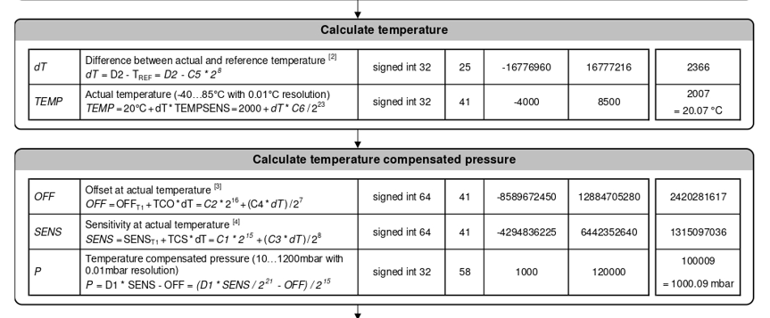
MS5611 CONFIGURATION
Calculating temperature and pressure

